Slide 1
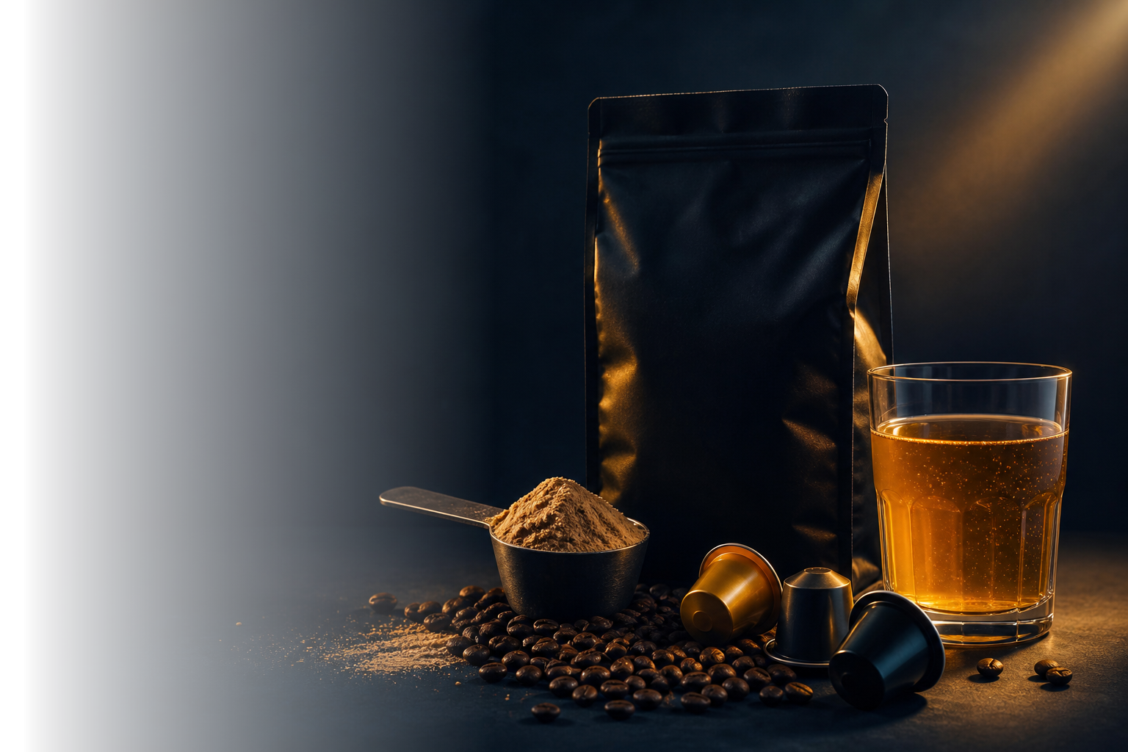

Coffee Hub
ARTEMIS
THE NOURISHING ALLIANCE
ARTEMIS · WORKSTREAM 04
Functionals
MEXICO AND COSTA RICA
Of the six workstreams, the only one whose N10 the deck flags as “preliminary estimates subject to change pending further analysis”. This is that analysis.
Own shelf and e-commerce census · Euromonitor Passport · September 14, 2026
BY
1/7

Slide 2
Coffee Hub
ELEVEN CATEGORIES
BIA COFFEE HUB · WORKSTREAM 04 · FUNCTIONALS
THE NOURISHING ALLIANCE
Eleven categories already sell function. Coffee, not yet
Every category with a functional offer, in both countries: what it is worth and which function it carries.
CATEGORY · KEY FUNCTION
🇲🇽 MEXICO USD MILLION
🇨🇷 COSTA RICA USD MILLION
Yogurt
3,721
130.6
ADDS
digestive · probiotic
Baby food
2,961
46.9
ADDS
fortified by law
Bottled water
2,845
201.1
NONE
pure hydration
Infant formula
2,665
15.5
ADDS
fortified
Sports drinks
2,147
79.0
ADDS
electrolytes · Electrolit, Suerox, Gatorade
Breakfast cereal
1,303
101.9
ADDS
vitamins and iron
Sugar-free soda
1,045
50.8
REMOVES
reduced sugar
Energy drinks
1,041
115.6
ADDS
caffeine · taurine · Vive 100, Red Bull, Raptor
Ready-to-drink tea
475
159.8
ADDS
antioxidant · sugar-free
Ready-to-drink coffee
62
6.1
EMPTY
none today · Me Latte leads in CR
Protein bars
29
3.7
ADDS
protein · energy
13,867
493
THOSE THAT DO ADD
ADDS function added · REMOVES something removed · NONE nothing · EMPTY no function
◆
IMPLICATION
FOR BIA
USD 13,867 M in Mexico and 493 M in Costa Rica already add function. RTD coffee does not.
Euromonitor Passport, Retail Value RSP in USD, 2025 — query of Sep 14, 2026 · the eleven are categories of the Passport tree, not claims: that is why both countries have a figure · “sports drinks” includes oral rehydration solutions (Electrolit, Suerox) per the report “Sports Drinks in Mexico” Nov 27, 2025 · Dos Pinos’ lead in Costa Rican RTD coffee: “RTD Coffee in Costa Rica” Dec 24, 2025
BY
2/7

Slide 3
Coffee Hub
REMOVE OR ADD
BIA COFFEE HUB · WORKSTREAM 04 · FUNCTIONALS
THE NOURISHING ALLIANCE
Health sells by removing. Adding is the small part
Each category’s market size, its leading health claim, and the share that is truly functional.
CATEGORY
SIZE IN MEXICO · USD MILLION
ITS LEADING HEALTH CLAIM
USD M
REMOVES OR ADDS?
Staple foods
42,004
Gluten free
1,103
REMOVES
bread, tortilla, cereal, pasta
Soft drinks
32,599
Weight management
5,567
REMOVES
soda, juice, water, energy
Dairy
23,238
Lactose free
2,866
REMOVES
milk, yogurt, cheese, ice cream
Snacks
20,223
Gluten free
510
REMOVES
snacks, cookies, chocolate, bars
Cooking & meals
8,904
Natural
521
NO ADD
oil, sauce, soup, ready meals
Hot drinks
3,724
No caffeine
205
REMOVES
coffee, tea, powders
TOTAL
130,694
REMOVES = something taken out (gluten, lactose, sugar, caffeine) NO ADD = natural, untouched
10,771
SUM, NOT TOTAL
6
WHAT IS TRULY FUNCTIONAL, IN BOTH COUNTRIES · sports + energy + bars, 2025
MEXICO
USD 3,217 M
COSTA RICA
USD 198 M
of 6
9.9%
12.9%
No leading claim adds anything. All remove — or add nothing.
sports 2,147 · energy 1,041 · bars 29
energy 116 · sports 79 · bars 4
Costa Rica devotes a larger share than Mexico — and to energy, not sports drinks. Passport measures them as categories: that is why both countries have a figure.
◆
IMPLICATION
FOR BIA
A functional coffee adds. That runs against the best-selling claim in all six categories.
Euromonitor Passport, Retail Value RSP in USD 2025 — query Sep 14, 2026 · leading claim: Health and Wellness reports for Mexico ed. Jan 12, 2026 (2024 data), at 20.064 MXN/USD · the leading claim is not the category’s total health value: Euromonitor publishes by claim and does not sum, because one product carries several · Costa Rica does not exist in the Health and Wellness system: it has size, not a claim cut
BY
3/7

Slide 4
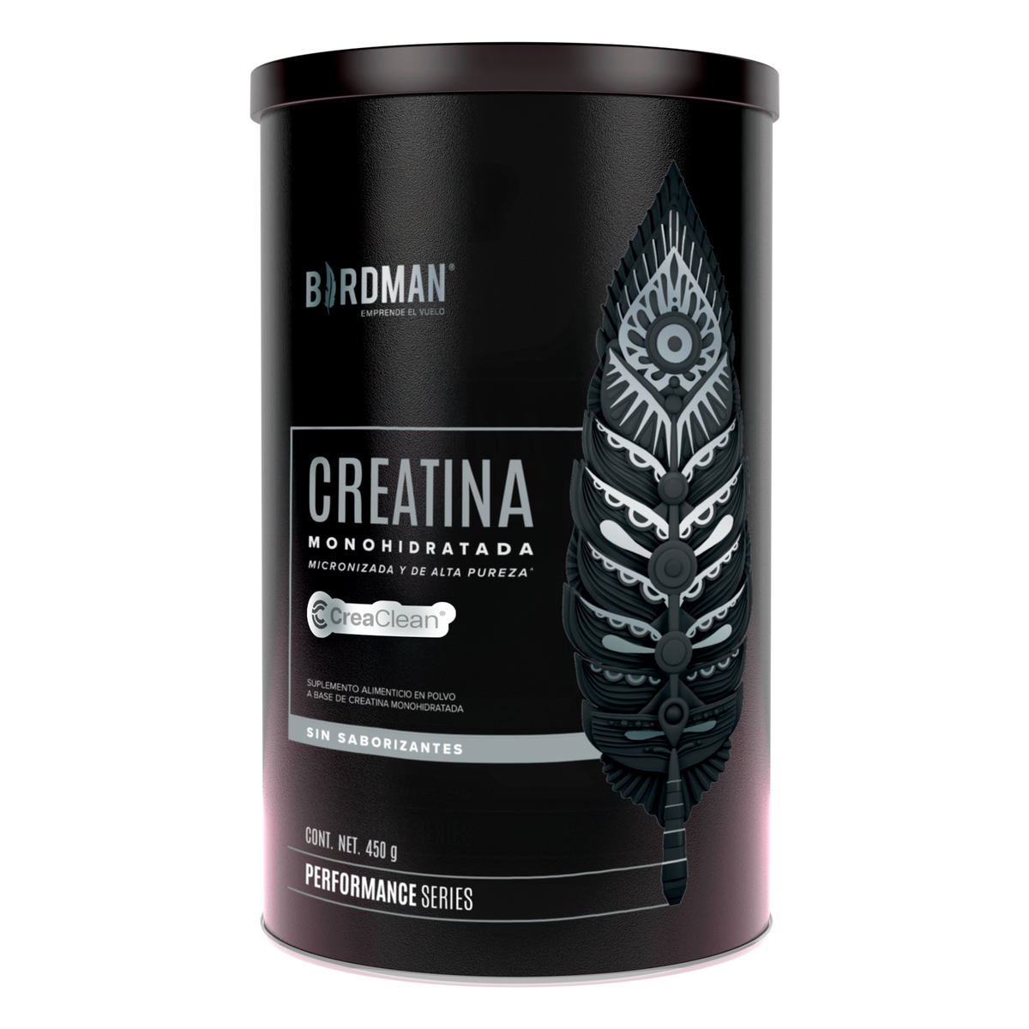
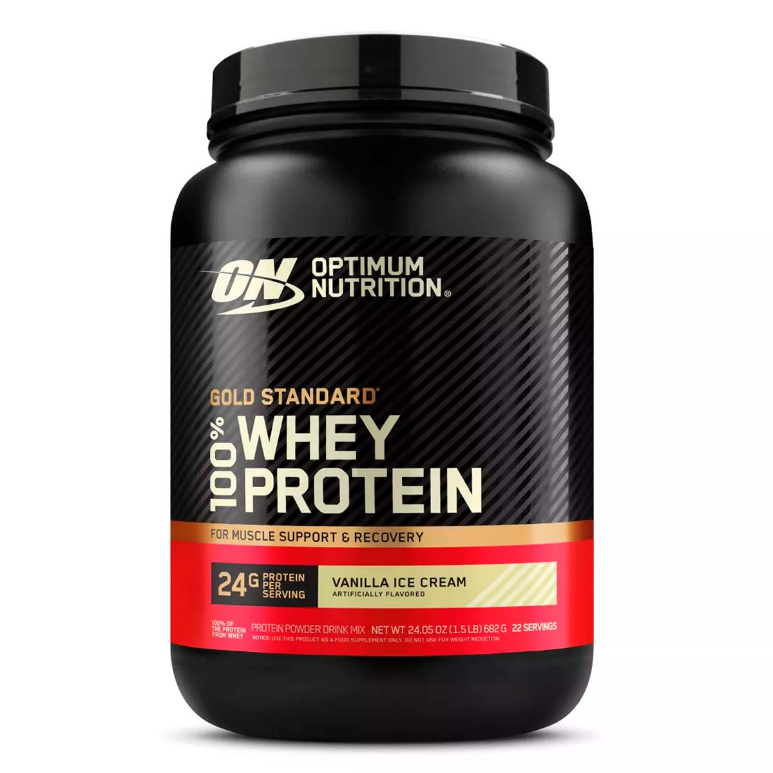
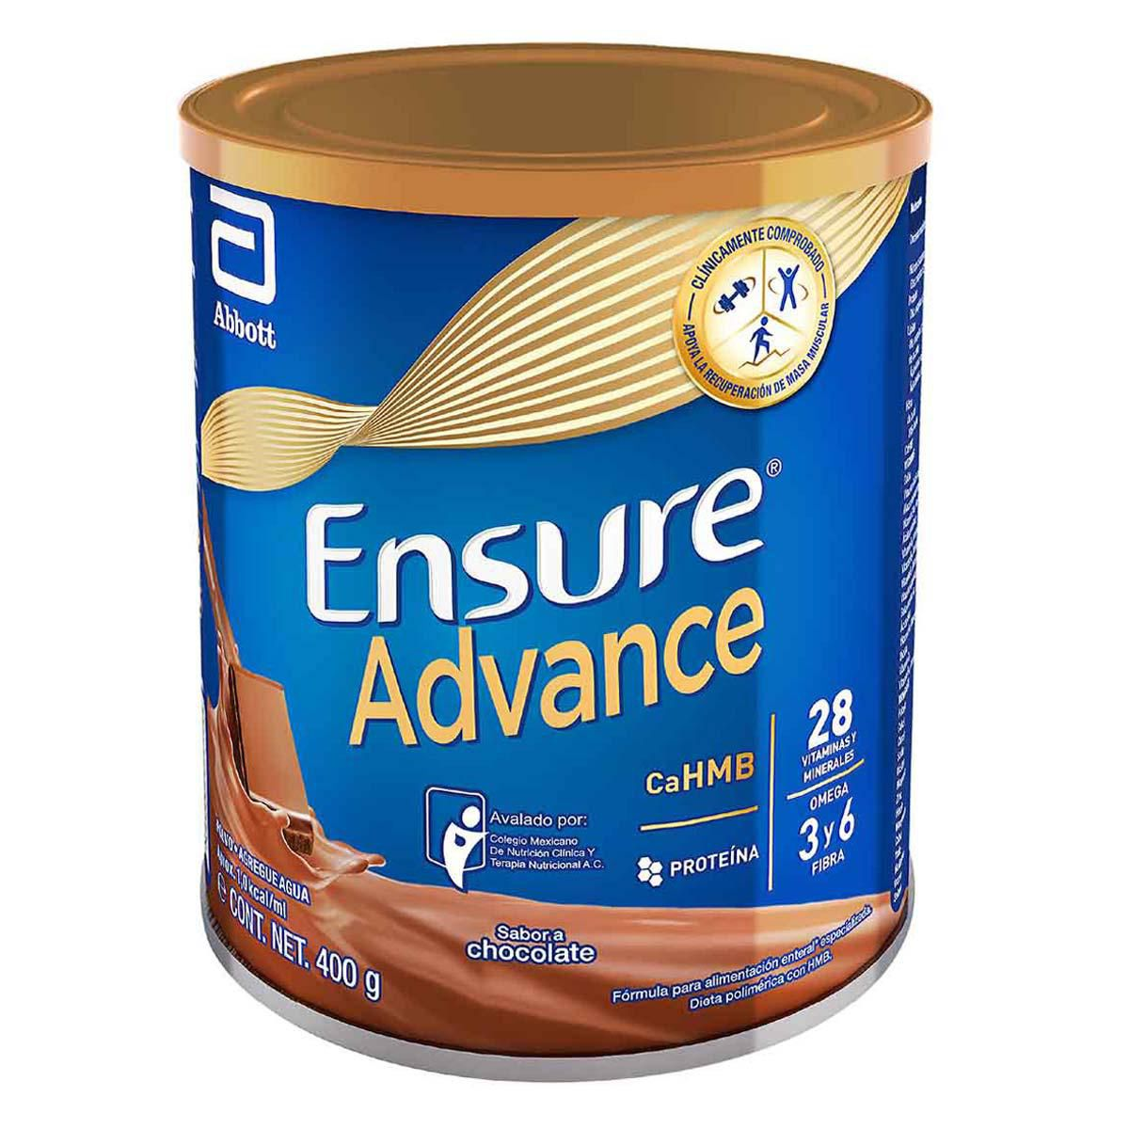
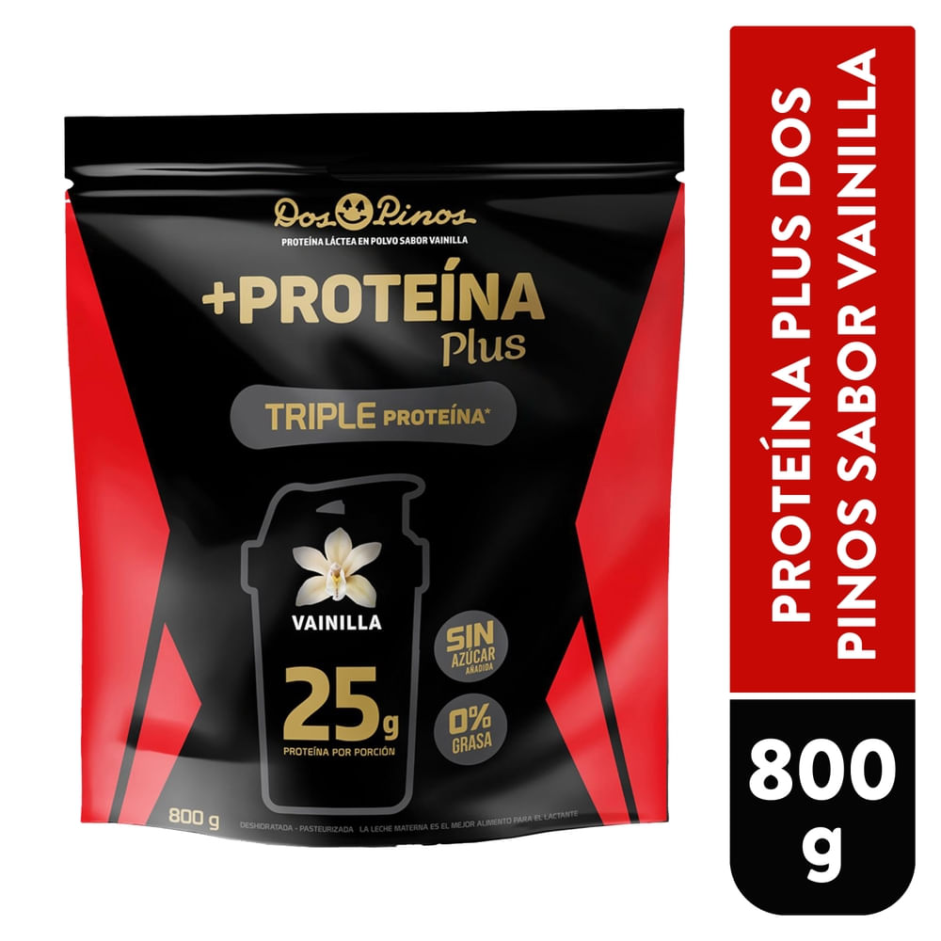
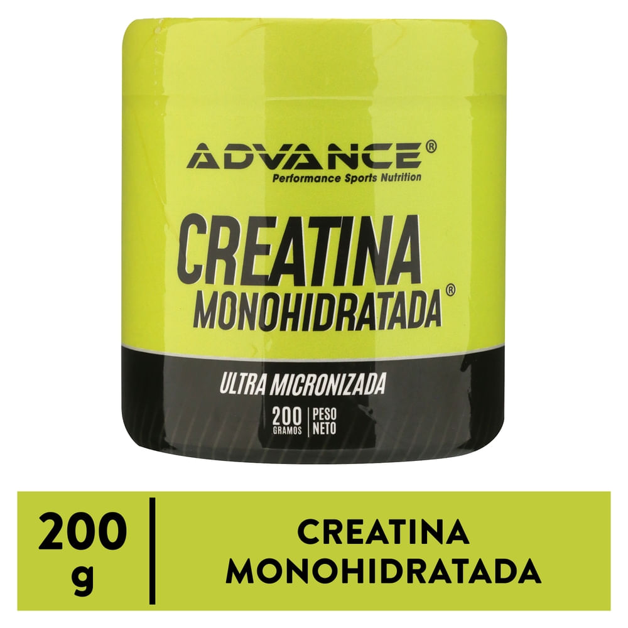
Coffee Hub
MATRIX · FUNCTIONALS
BIA COFFEE HUB · WORKSTREAM 04 · FUNCTIONALS
THE NOURISHING ALLIANCE
Outside coffee they do know how to add
The five best sellers. Below, who already sells each function — and outside coffee they are different: here muscle, hydration and age rule.
41,903 reviews
64,738 reviews
13 g protein + HMB
25 g per serving
₡13,000 200 g
Creatina Birdman
ON Gold Standard
Ensure Advance
Dos Pinos Deportista
Creatina Advance
BRAND
WHERE IT SELLS
💪 MUSCLE
💧 HYDRAT.
🌀 DIGEST.
✦ BEAUTY
✚ AGE
🍃 REMOVES
● the brand already sells a product with that function
SPORTS POWDERS
●
●
Birdman 🇲🇽
Amazon · Costco · Fahorro
4 of the top 8 on Amazon MX
Powerlab · Perform · Pura Prote 🇨🇷
own store · Auto Mercado
●
●
●
the three native Costa Rican brands
Optimum · Dymatize · MuscleTech
Auto Mercado · Goodlife
●
●
nearly the full global portfolio is in CR
DAIRY
●
●
●
Dos Pinos 🇨🇷
Walmart CR · Auto Mercado
3 of 6 · and since 2024 leads Costa Rican RTD coffee
Yakult · Danone · Activia 🇲🇽
supermarkets · Yakult Ladies
●
Yakult: 3.99 M bottles a day · all three in CR: zero
BEVERAGES
●
Electrolit 🇲🇽
pharmacy · supermarkets · CR
87% of oral rehydration · sold as a medicine, not a food
Gatorade · Powerade · Suerox
supermarkets in both countries
●
●
hydration is an imported-brand game
Kombucha Culture 🇨🇷 · Bonsaly 🇲🇽
Walmart CR · Chedraui
●
12 SKUs in CR · in Mexico, just one
Tropical · Cristal (FIFCO) 🇨🇷
supermarkets
●
its “healthy” move is tea and water
MEDICAL NUTRITION
●
●
Ensure · Glucerna · PediaSure
every pharmacy and supermarket
13 g of protein and 1.5 g of HMB · Nestlé is nowhere
Herbalife
direct selling
●
●
the most expensive meal replacement in CR
THE GAP
Protein bars · risk-reduction claims
supermarkets
9 SKUs in the whole country · of the 14 health claims the Central American standard (RTCA) allows, zero in use
◆
IMPLICATION
FOR BIA
In Costa Rica, the closest to owning function is a dairy, not a coffee company.
Own shelf and e-commerce census, Sep 14, 2026 · VTEX catalogs of Walmart CR, Más x Menos and Chedraui · Auto Mercado · PriceSmart CR · Costco MX · Amazon MX · Farmacias del Ahorro · GNC MX · images from the retailers’ own product pages · Electrolit: business press, not audited · RTCA 67.01.60:10 Annex G
BY
4/7

Slide 5
Coffee Hub
COFFEE · TAM SAM SOM
BIA COFFEE HUB · WORKSTREAM 04 · FUNCTIONALS
THE NOURISHING ALLIANCE
Functional coffee does not exist yet
Three nested sizes: TAM = all coffee · SAM = the share that already talks health · SOM = truly functional coffee. In dollars, by country.
🇲🇽 MEXICO
🇨🇷 COSTA RICA
TAM
All coffee sold at retail
100%
TAM
All coffee sold at retail
100%
USD 3,062 M
USD 345 M
MXN 61,444 M
99% roast & ground
SAM
Coffee with a health claim
19.0%
SAM
Coffee with an attribute (specialty, organic, decaf) · wide range due to unmeasured sales velocity
est.
USD 580 M
USD 20–90 M
MXN 11,643 M
own estimate · midpoint USD 52 M
SOM
Fortified claim · growing +18% a year
3.6%
SOM
No SKU with a functional claim
0%
USD 110 M
USD 0
MXN 2,211 M
0 of 219 SKUs measured
· · · READ AGAINST THE ARTEMIS RULES · · ·
THE ENTRY FLOOR
THE TARGET ALREADY SET
WHAT IT IS MADE OF
▲
3.6% vs the 5%
◎
15 of 110
⚗
95% is instant
Rule 01 of the capsules playbook bars any segment below 5% of the coffee category. Functional weighs 3.6%.
ARTEMIS assigned it USD 15 M of N10 revenue (10-year target). Against the measured pool of USD 110 M, that is asking for 14% of all functional coffee in Mexico.
Of the USD 110 M, only USD 5.7 M is ground coffee — BIA’s business. The rest is instant with vitamins.
◆
IMPLICATION
FOR BIA
The edge is not being first, but having the asset built — and BIA already has it: Bulletproof.
Euromonitor Passport, Hot Drinks › Coffee, Retail Value RSP, ed. 2025 · FX 20.064 MXN/USD · own shelf census Sep 14, 2026 · Costa Rica’s SAM is an own estimate, not published data: two independent methods give USD 20–90 M, midpoint 52 M · the ≥5% threshold is rule 01 of the capsules playbook (ARTEMIS slide 58), applied here by analogy · the USD 15 M N10 — ARTEMIS slide 6
BY
5/7

Slide 6
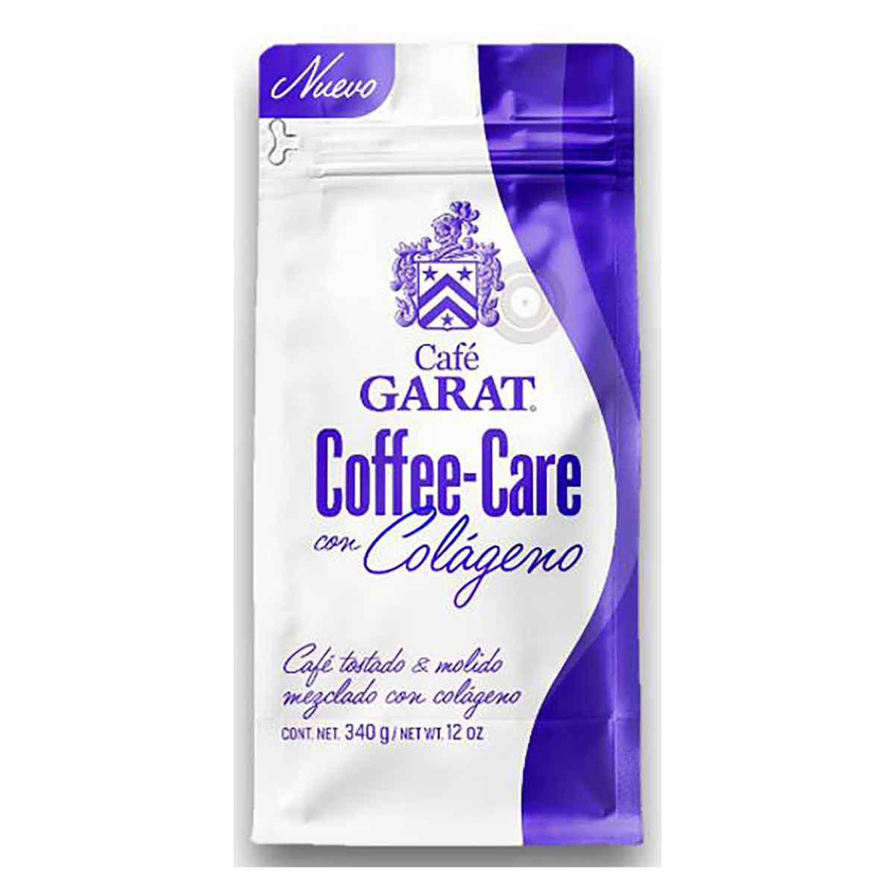
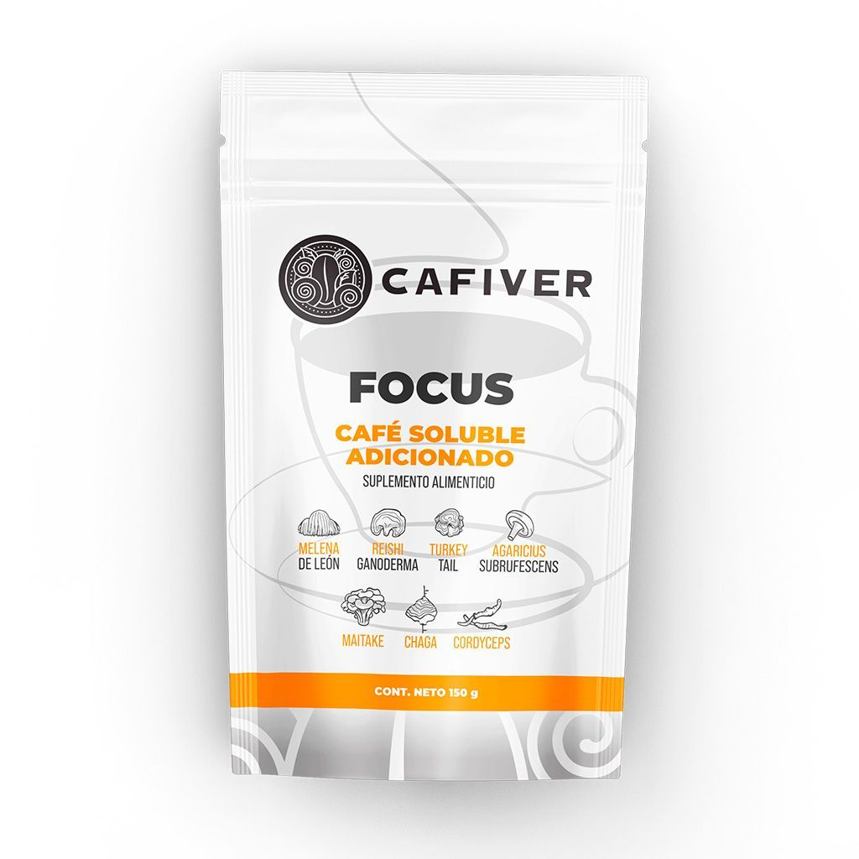
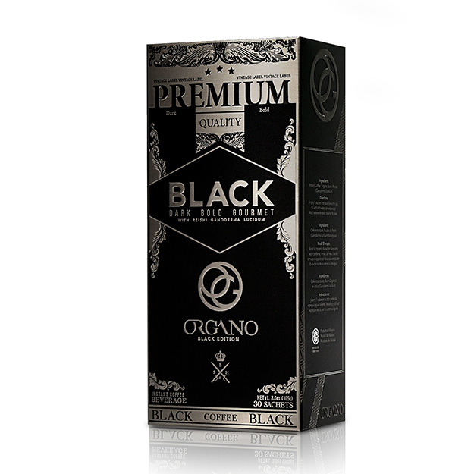
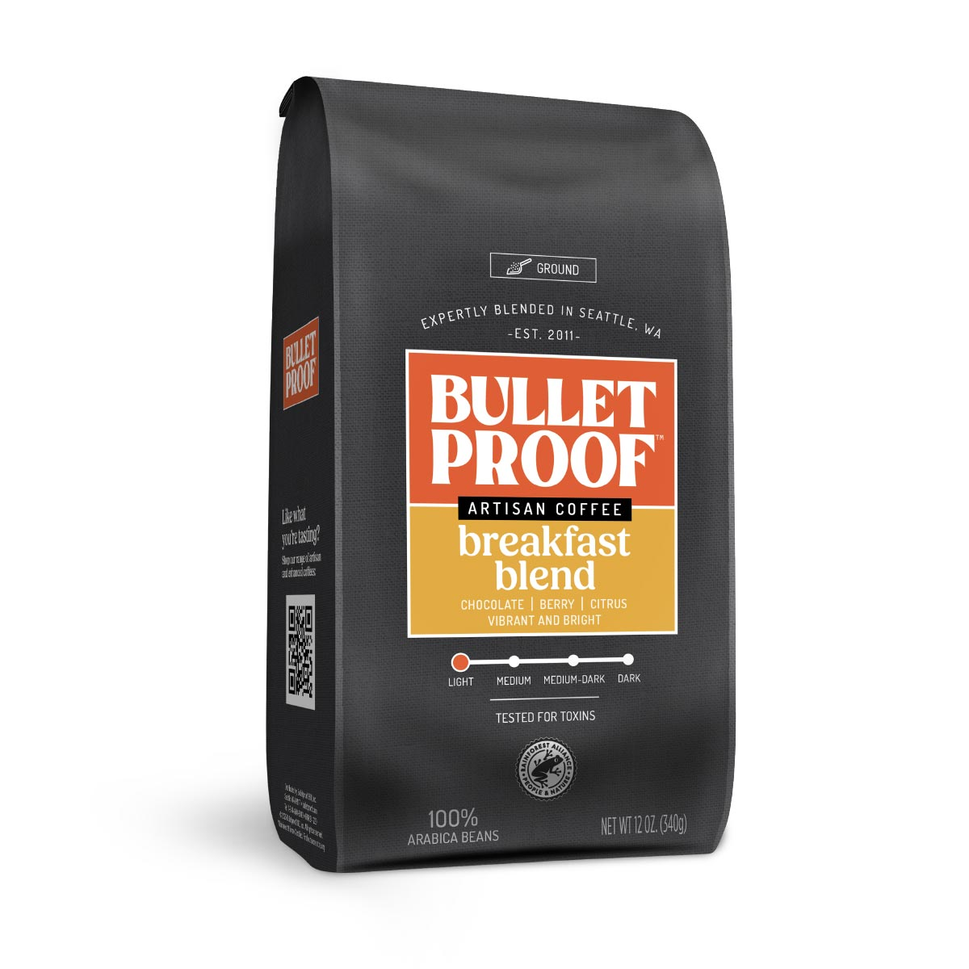
Coffee Hub
WHO PLAYS
BIA COFFEE HUB · WORKSTREAM 04 · FUNCTIONALS
THE NOURISHING ALLIANCE
Only one coffee house dared
Five players, five different channels — and only one reaches the coffee aisle.
+20%
3 of 6
0 on shelves
25 g
2024
Garat · Sabormex
Cafiver
ORGANO · DXN
Dos Pinos
Bulletproof
Premium over its own regular coffee · the only functional one on the shelf
Functions it already formulates —collagen, ganoderma, probiotics— and none reaches the shelf
Decades selling ganoderma coffee, all through affiliate networks
Of protein per serving. And since 2024 leads Costa Rican RTD coffee with Me Latte — without crossing the two
Year it joined BIA · already sells creatine coffee in the US
· · · WHAT THE SHELF REVEALS · · ·
FINDING 1
FINDING 2
FINDING 3
◆
It came in through beauty
●
Pharmacy first
◆
The dairy is already in the cup
The only coffee house playing did it with collagen, not mushrooms.
Mushroom coffee reached Farmacias del Ahorro before the supermarket.
Dos Pinos formulates protein and since 2024 leads Costa Rica’s RTD coffee. What it has not done is cross the two.
◆
IMPLICATION
FOR BIA
The category’s founding brand is already in-house: Bulletproof, BIA’s since 2024.
Own shelf census, Sep 14, 2026 · images from the retailers’ own product pages · Dos Pinos’ entry into RTD coffee with Me Latte in 2024 and its lead: Passport, “RTD Coffee in Costa Rica”, Dec 24, 2025
BY
6/7

Slide 7
Coffee Hub
MATRIX · COFFEE
BIA COFFEE HUB · WORKSTREAM 04 · FUNCTIONALS
THE NOURISHING ALLIANCE
Six functions in coffee. One reached the shelf
49 coffee products censused in Mexico and Costa Rica, crossed by brand, channel and function.
MEXICO
TAM
SAM
SOM
COSTA RICA
TAM
SAM
SOM
USD 3,062 M
USD 580 M
USD 110 M
USD 345 M
USD 20–90 M
USD 0
all coffee
with a health claim
fortified · +18%/yr
all coffee
midpoint USD 52 M
0 of 219 SKUs
BRAND
WHERE IT SELLS
BEAUTY
FOCUS
KETO
MUSCLE
DIGEST.
IMMUNE
● the brand already sells a product with that function
ON THE PHYSICAL SHELF
●
Garat (Sabormex)
Chedraui · Costco · Soriana
●
the only one in supermarkets
Beyond Vitamins
Farmacias del Ahorro · Amazon
●
came in via pharmacy
Starbucks México
its own coffee shops
protein latte, not packaged
E-COMMERCE ONLY
●
●
●
●
●
Earth Co
own store · Amazon
●
●
●
6 of 6 — and all sold out
Cafiver (70 years)
only its e-commerce
●
●
the traditional roaster
UNRULED · cafécoffee
own store · Amazon
●
●
all 3 flavors sold out
BPN PRO / Balanfood
own store · Amazon
●
café de olla
Khaley · DOSE OF
own store
●
812 and 572 reviews · the most traction
Cafelágeno
own store · Amazon
●
Vidaflora · Suntup · Hydrashot
DTC and marketplace
●
three brands, one single claim
Four Sigmatic (imported)
Amazon
interest −79% from its peak
DIRECT SELLING · MLM
●
Organo Gold · Gano Excel · DXN
affiliate network
●
the historic channel, no public price
It Works!
affiliate network
keto coffee
COSTA RICA
No Costa Rican coffee brand
—
●
zero in formal channels, verified brand by brand
Gano Excel · Omnilife
direct selling
●
the only thing that exists, and it is not shelf coffee
Dos Pinos
Walmart CR · Auto Mercado
dairy with 13 protein SKUs · and since 2024 leads Costa Rican RTD coffee
◆
IMPLICATION
FOR BIA
Of six functions, only collagen reached the shelf.
Own shelf and e-commerce census, Sep 14, 2026 · VTEX catalogs of Chedraui, Soriana, Walmart CR and Más x Menos · Costco MX · Farmacias del Ahorro · Amazon MX · each brand’s own store · Mercado Libre blocked product pages (403): the keto/fat-burn block has no verified price · MLM sites publish no list price
BY
7/7

